Slide 1
Midge.xyz
Bassan Davide
2017-2018

Slide 2
<p>Sommario</p>
# INTRODUZIONE # LOGIN # CHAT # GAMEPLAY # COLLISION

Slide 3
#DEFINE VIDEOGAME

Slide 4
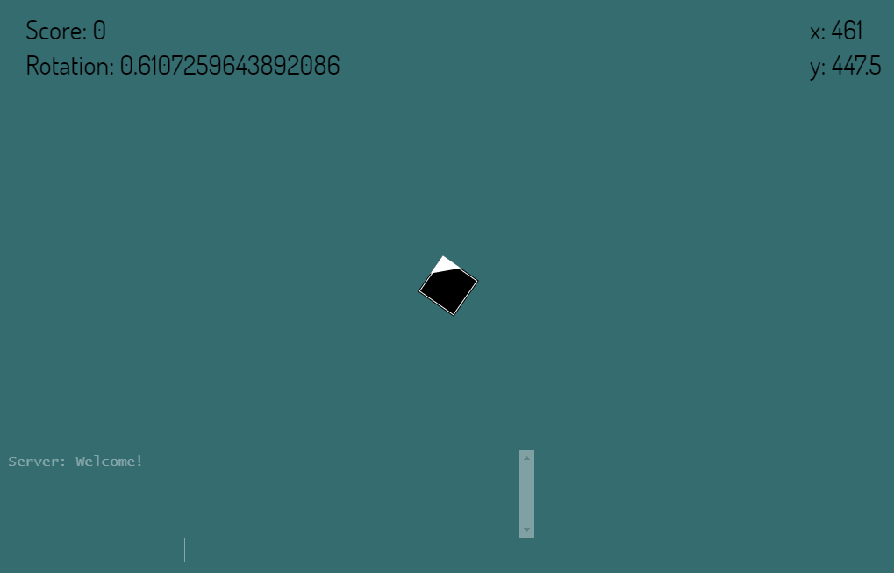

Slide 5
#DEFINE LOGIN

Slide 6
#BEHIND SIGN IN
GIOCATORE
send(user, password)
SERVER
1
4
send(accept/refuse)
2
send(true/false)
check(user,password)
3
DATABASE

Slide 7
#DEFINE CHAT

Slide 8
#CHAT PERMISSION
 | MESSAGGI | QUERY
USER
ADMIN

Slide 9
#COMMON CHAT
forward(data)
5
1
SERVER
forward(data)
forward(data)
6
send(‘hey’)
forward(data)
Hei
4
forward(data)
2
3

Slide 10
#CHAT QUERY
send(‘/Player.list’)
SERVER
ADMIN
return(data)

Slide 11
#DEFINE GAMEPLAY

Slide 12
ROTATE

Slide 13

x
atan((midge.x – mouse.x) / (midge.y – mouse.y))
{
x’ = x cos α + y sen α
y’ =-x sen α + y cos α
α
0
y

Slide 14
MOVE

Slide 15
KEYBOARD COMMANDS
W
W
W
A
S
D
S
S
D
A
D
A

Slide 16
#DEFINE COLLISION
2
3
1

Slide 17
1

Slide 18
2

Slide 19
3

Slide 20
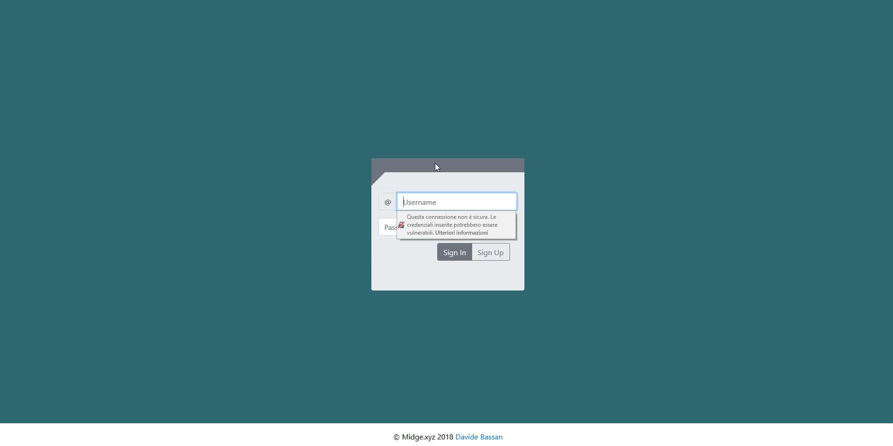

Slide 21


#SHARING
#ONLINE
http://www.midge.xyz

Slide 22
GRAZIE PER L’ATTENZIONE

